Slide 1
Chapter 10
Strategic Analysis

Slide 2
Outline
How can you use information technology to improve your organization and make it better than your competitors?
How competitive is your world?
What are the main factors affecting a firm’s competitive advantage? Where do you begin looking for an edge?
How can you use IT to gain a competitive advantage? Where do you begin your search?
How can IT support the operations of the firm to provide a competitive advantage?
Why is it so difficult to convince management to make strategic changes? What are the risks of strategic decisions?
Why did so many dot-com firms fail? Do their failures mean there is no viable Internet strategy?
How do you convince an organization to change strategies?

Slide 3


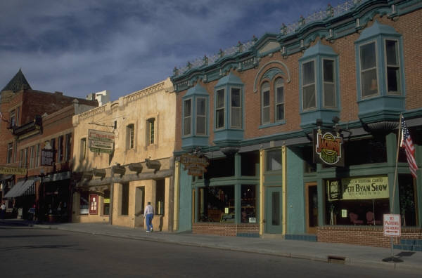
Strategy
Connections to suppliers and customers.
Competition
Become the best firm in the industry. Block the competitors by keeping your customers happy.

Slide 4
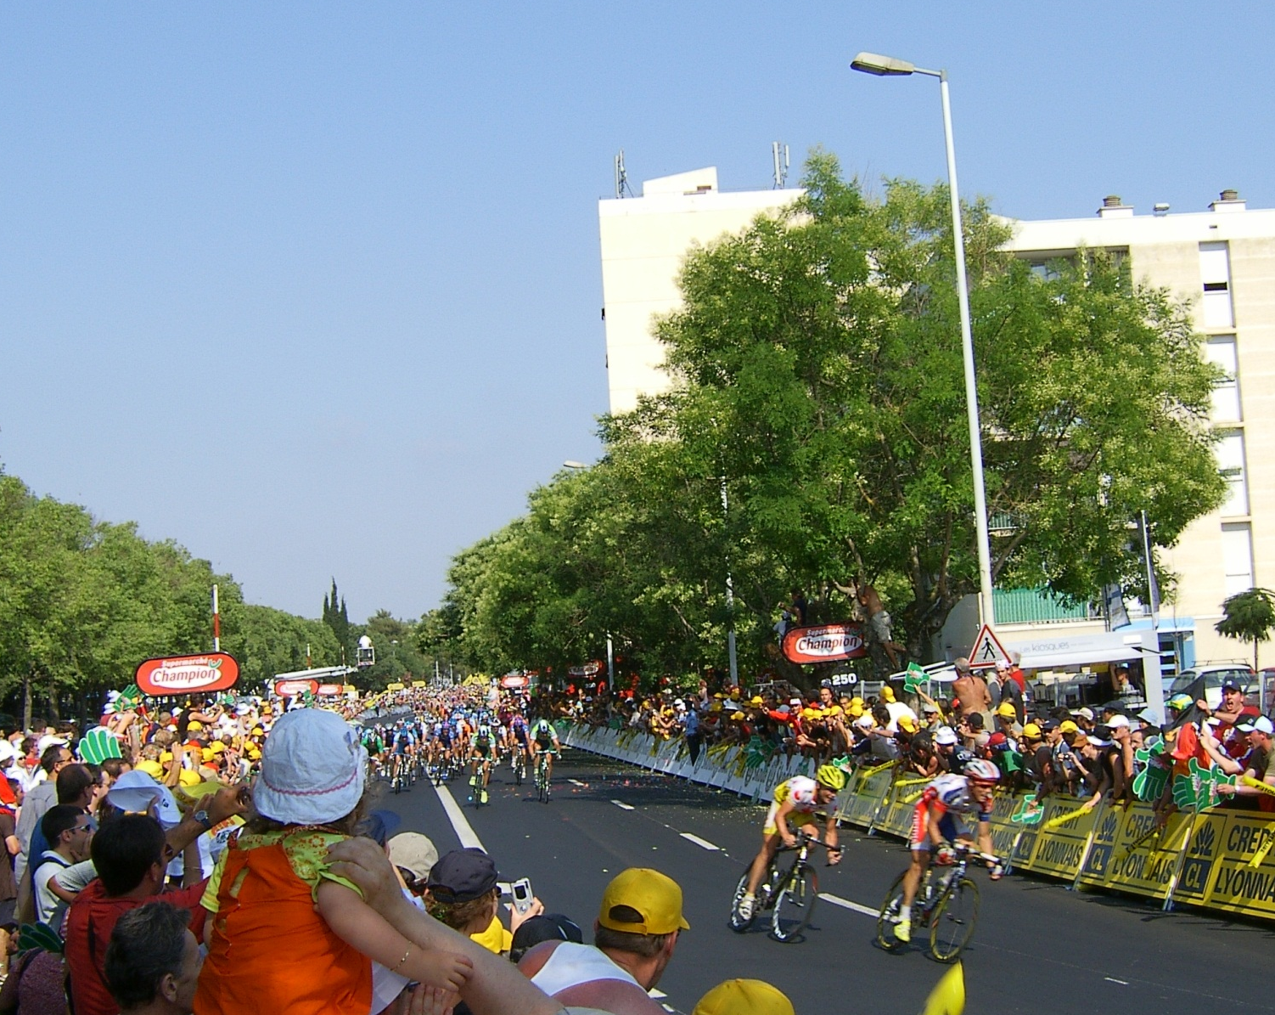
Competition
How competitive is your industry?
Even with one or two front-runners, you might have a pack of hungry competitors chasing you down.
2005 Tour de France: Montpellier

Slide 5
Competition
Mergers and consolidation
Pick an industry and name the top firms.
Most industries are dominated by five or fewer firms. (Look up concentration ratios.)
International
Firms: Many large firms around the world compete directly or indirectly.
International markets enable firms to become larger—because of more customers.
Costs: It is common to move production to locations with large labor pools and low wages.
Large firms that compete on price continually squeeze suppliers to cut costs.
Consumers have access to increasing amounts of price and comparison data for all products and services.

Slide 6
Porter’s Five Forces Model
Threat of
New Entrants
Bargaining Power
of Suppliers
Rivalry Among
Existing Competitors
Bargaining Power
of Buyers
Threat of Substitute
Products or Services
Government (not part of Porter’s model but critical today.)

Slide 7
Production Chain
parts
supplier
parts
supplier
parts
supplier
warehouse
warehouse
supplier
supplier
supplier
tool
manufacturer
workers
Manufacturer
wholesaler
wholesaler
distributor
distributor
distributor
retail store
retail store
retail store
retail store
Consumers

Slide 8
Production and Service
Who are your customers?
Short answer: everything between you and the final sale.
Can you connect with the multiple levels of customers?
Where are the profits and competition in the industry?
Would you be better off by extending across multiple levels?
How can you control quality?
Quality begins at the lowest levels of suppliers and materials and must be tracked and monitored.
Quality includes workers and tools.
It also requires matching the product or service to the needs of the customers.

Slide 9
Methods to Gain Competitive Advantage
Barrier
To Entry
Supplier
Supplier
Supplier
Ties To
Suppliers
Decreased
Costs
Firm
Rival
Improved
Quality
Control Of
Distribution
Wholesale
Ties To
Customers
Innovation and
Differentiation
Consumer
Consumer
Consumer
Increased
Switching Costs
Consumer
Consumer
Consumer
Consumer

Slide 10
Barriers to Entry
Economies of Scale (size)
Economies of Scope (breadth)
Product Differentiation (patents)
Capital requirements
Cost Advantages (independent of size, such as better management or suppliers)
Distribution Channel Access
Government Policy

Slide 11
Competitive Advantage
Barriers to Entry
Additional costs of creating an information system. People Express
Distribution Channels
Prevent others from entering the industry. iTunes
Switching Costs
Consumers incur learning and data transfer costs. Baxter Healthcare
Lower Production Costs
IS to cut costs. Wal-Mart
Product Differentiation
Add new features or create new products with IT. Federal Express & Merrill Lynch
Quality Management
Monitoring production lines and analyzing data. Digital Equipment Corp.
Value Chain
Expanding forward or back the value chain to find greater profits. Qwest

Slide 12
Value Chain
Firm Infrastructure
Human Resources Management
Margin
Technology Development
Procurement
Inbound Logistics
Operations
Outbound Logistics
Marketing & Sales
Service
Margin

Slide 13
Process Innovation
Suppliers
Production
Research
Logistics/
Supply
Engineering
and Design
Management
Manufacturing
Marketing
Customer
Service
Sales and
Order
Management
Customers

Slide 14




Innovation is Not Enough
Strategy idea
Data
Convince top management
Competition
Costs
Forecast
Research/Plan
Implement and Monitor

Slide 15
Search for Innovation
Research
Analysis & modeling, project management, work group support, databases, decision support.
Engineering & Design
CAD/CAM, testing, networks, work group support.
Manufacturing
Mass customization, links to customers & suppliers, quality monitoring, expert systems for maintenance, production databases, business integration.
Logistics & Supply
Just-in-time linkages, forecasts, models, links for design, transaction processing.

Slide 16
Search for Innovation
Marketing
Frequent buyer database, target market & media analysis, survey design and analysis, multimedia promotion design, links to customers and designers.
Sales & Orders
Portable computers for sales, ES for order customization, work group tools for customer support.
Service
Phone support, GIS locators, scheduling, ES diagnostics, databases.
Management
EIS, e-mail, bulletin boards, decision support systems, personal productivity tools, work group support
Links to service providers
Accountants
Consultants
Lawyers, . . .

Slide 17
Research
Analysis and models
Statistical analysis of data
Project management and budgeting
Work-group collaboration and communication

Slide 18
Engineering and Design
CAD/CAM
Integrated design database
Production databases and model testing
Expert Systems for manufacturability
Work group communication

Slide 19
Manufacturing
Links to customers
Links to suppliers
Mass customization
Robotics
Diagnostic Expert Systems
Quality monitoring and control

Slide 20
Logistics and Supply
Just-In-Time Inventory and EDI
Configuration and design
Searching for availability, pricing, . . . networks

Slide 21
Marketing
Frequent buyer databases
Point-of-Sale and trends
Statistical analysis of data
Geographic Information Systems
Links to external marketing agencies
Multimedia development of promotions
Internet
Social network monitoring and evaluation

Slide 22
Sales and Orders
Sales force automation, hand-held computers
Customer Internet access
Expert Systems for product and option selection
Expert Systems for configuration and shipping
Front-line support: ES, e-mail, work groups

Slide 23
Service
Portable computers for service anywhere
Databases (e.g., customer service)
Location monitoring of service personnel
Product internal, automatic diagnostics
Expert System diagnostic tools

Slide 24
Management
Executive Information Systems
Simulation (and rivalry games)
Links to external partners (accounting, law, . . .)
Electronic conferencing
Work group communication, e-mail
Standardization, Modularization, Franchises
Knowledge Workers
Client-server instead of hierarchical computing

Slide 25
Strategy Analysis
Product Differentiation
Skills & Resources
Strong marketing.
Product engineering.
Basic research.
Distribution channel cooperation.
Organization Requirements
Internal coordination.
Incentives for innovation.
Resources to attract skills.
Risks
Competitors imitate.
Customers do not accept.
Cost is too high.
Cost Leadership
Skills & Resources
Continued capital investment.
Process engineering.
Continuous quality improvement.
Tight supervision of costs.
Products designed for low cost.
Low cost distribution.
Organization Requirements
Tight cost controls.
Frequent control reports.
Highly structured org.
Incentives based on qualitative measures.

Slide 26
Strategy Analysis
Cost Leadership
Risks
Competitors imitate.
Technology changes.
Lose production or distribution advantage.
Customer-Supplier Links
Skills & Resources
Influence with partners
Communication channels
Standards or agreements.
Organization Requirements
Flexibility to respond to customers.
Service culture.
Ability to adapt to emergencies.
Risks
Security threats.
Changing standards.
Competitors copy with more/better links.

Slide 27

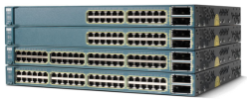
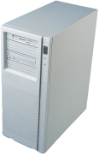
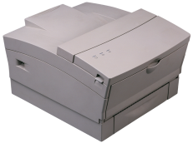
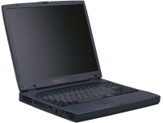
Dangers: Capital Cost
Money for research
Money for information technology

Slide 28
Competition Follows
IS Costs
You
Time
Transaction
Processing
Network & link
sales people
Experimental
technology
& global links
IS Costs
Rival
Time
Network & DSS
Link to suppliers
& customers
Notes:
Strategy is similar to chess. You must plan several moves ahead.
Implementing a technology is not a single thing at one time.
It means planning for responses by rivals and knowing your next moves and estimating the future costs.
You might not have a choice, but you should at least estimate the future changes and costs.

Slide 29
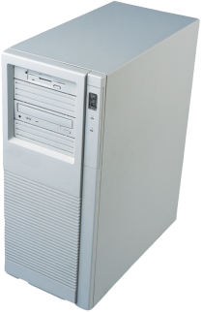
Changing Industry & Government Intervention
New technology
New services
Customer
Customer
Customer
Industry 1
(expands into
industry 2)
Industry 2
(new
competitor)
Customer
Customer
Same technology
Customer
Customer
Customer
Notes:
Technology can enable you to expand into new industries.
But, beware of the competition in that industry.
You might eventually have to deal with that competitor regardless of whether you initiate the change, but you need to plan ahead and determine the best way to deal with that potential competitor.
A classic case: A relatively small company was successful in selling services to other businesses to process benefits, such as insurance and retirement accounts. The company decided to expand by adding payroll processing, which sounds like a great idea because it uses much of the same data.
But, there is an 800-pound gorilla in payroll processing—ADP.
When ADP realized firms wanted benefits and insurance processing, it was easy to add them and take over most of the market.
Instead of trying to compete directly, it might have been better for the first firm to find a way to partner with ADP.

Slide 30




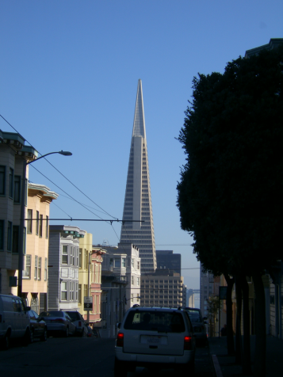

Security
Production Firm
Internet router
rejected
Hackers
or competitors
External firewall
Internal firewall
Web servers
Data to be protected.
Data to be shared.
Need to control access.
Need to worry about network
interceptions and hackers.
Securing data is harder when you want to share some and protect the rest.

Slide 31
Web Strategies: Newspaper Example
By the 2000s, most newspapers and magazines provided free access to online content. (Except the Wall Street Journal.)
By 2010, most were losing print subscribers and print advertising revenue.
Some decided to create a “pay wall” to offer some free content and charge for subscriptions
Which is a big risk
Fees might drive away readers, limiting subscription revenue
And reducing the amount of money received through advertising
But, can Web advertising support thousands or millions of Web sites?

Slide 32
Sustainability
$
Additional profits
Technology creates barriers or switching costs so you gain profits.
time
Technology cost
$
Additional profits
Anyone can copy your strategy and competitors attract customers.
time
Technology cost

Slide 33
Leader or Follower
$
Technology Costs
Leader
Follower
time
Leader | Follower
Lock in customers Reputation Lock in technologies Experience Lead for next step | Reduced risk—standards Lower cost Supplier experience

Slide 34
Change Agents
Change agent can be person or event (economic) that convinces organization to change its policies.
time
Change agent intervention
Continuous change where everyone is encouraged to contribute new ideas making many small changes over time.
time

Slide 35
Cloud Computing
Goals of cloud computing: reduce fixed costs and make similar technology available to even small firms.
The presence of open, low-cost services makes it difficult to use technology strategically.
But strategy depends on finding creative methods and ideas and using technology to implement them.
If your managers are better than others, the presence of low-cost technology can make it easier to test and explore new ideas.

Slide 36
Airline Industry: Classic Case
Before 1978: Highly regulated
Federal Aeronautics Administration (FAA): Safety
Civil Aeronautics Board (CAB): Business
Flight schedules, landing rights, gates, even fares
In 1978, the CAB was removed to increase competition
Landing times and gates are determined by auction.
Fares are set by airlines and the market.
Initially, little changed in the industry
Firms had established practices and were profitable.
People Express was started, receiving huge press
Southwest Airlines began its slow expansion

Slide 37
People Express
Very low costs.
Main airport in Newark NJ and all flights return there.
Initially East cost and New York to Florida.
High unemployment, many workers available.
No union workers—highly unusual for pilots.
Flew single jet type (Boeing 727).
Convinced FAA to allow two pilots instead of three.
No reservation system, no meals, pay for bags.

Slide 38
American Airlines (and others)
The situation
People Express could charge $70 for a round-trip flight.
You charged $250.
Possible options
Cut prices—but then lose money on every flight.
Emphasize service and marketing.
Reservations (certainty)
National and global routes
Meals and baggage handling
Negotiate with unions.
Adopt hub system.
Others?
But, it will not be enough. Look at any major business magazine cover from 1982-1984.

Slide 39
How can AA Beat People Express?
Recognize that there are two groups of travelers:
Those who will fly People Express.
Those who will not fly People Express.
Tourists v. Business
Charge different prices to each group.
How do you identify and separate the groups?
Tourists: Book flights in advance and willing to stay over Saturday night.

Slide 40

Yield Management
Problem: Need to sell cheap seats first and withhold enough to sell to expensive business tickets.
Every flight, every day, forecast number of business seats to hold.
Despite high costs of technology in the 1970s, AA (Sabre) saved data on all flights. The company was able to reload the data tapes and build a method to forecast the number of seats to hold.
People Express did not have the money to build a reservation system.
Southwest Airlines used loopholes to book their own flights.

Slide 41
The Web
Yield management worked for two decades.
But competition continued to increase—partly led by Southwest Airlines.
Reservation systems were spun off and operating under constraint rules.
Reservation systems powered the early Web sites (e.g., Travelocity=Sabre). But they collected a percentage fee for all bookings.
In 2011, American Airlines followed Southwest Airlines by requiring customers to book all flights at their own Web sites, because technology costs are low.

Slide 42
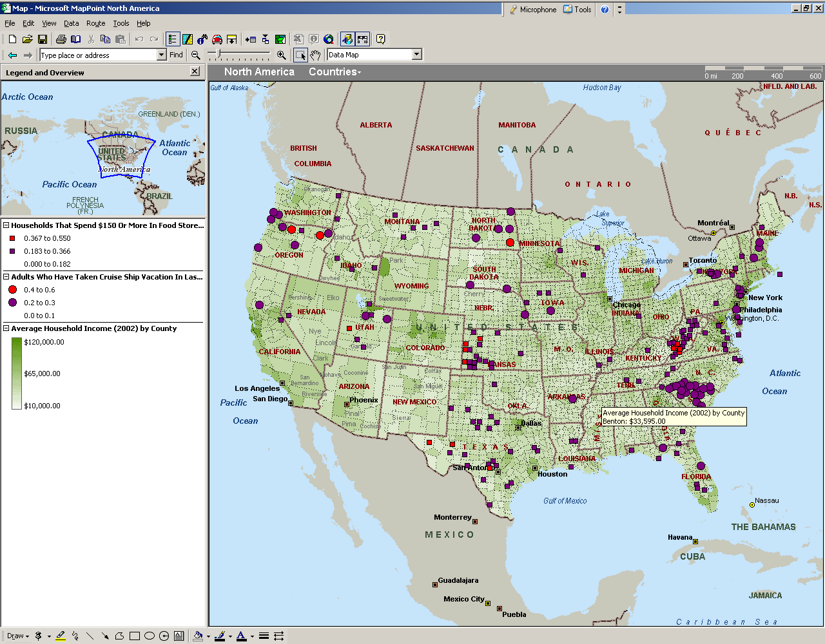
Technology Toolbox: GIS
Microsoft MapPoint
Data Mapping Wizard
Shaded Area: Demographics, Population 2002 by County
Multiple Symbol
Households with Internet Access
Three levels, lowest uses Blank8x8.bmp
MapPoint File: IncomeVersusInternetAccess2002.ptm

Slide 43
Quick Quiz: GIS
1. How often does the Census Bureau update its data?
2. Why is location an important element in business decisions?
3. How many location-based pie charts do you think could be placed on a map?

Slide 44
Technology Toolbox: Business Analysis
Foundation Solve the right problem Choose the right tools Divide the system Make a decision Consider the consequences Detail the implementation |  | Business Plan Problem description State facts and problems. Identify most important problems and causes. Plan Describe the new system. Detail how to implement the plan. Provide a contingency plan. Advantages Show how your plan will solve the problems. List additional advantages and strategic effects. |  | Expectations Measurable goals Financial implications Effect on human resources Strategic effects Critical success factors Potential risks

Slide 45
Quick Quiz: Business Analysis
1. Why is practice so important in learning to diagnose business problems? Where will you get this practice?
2. Where do you place the expectation elements in the business plan?
3. How is the problem description different for a business case compared to an actual business problem?

Slide 46
Cases: Airline Industry

